Slide 1
UML Modelling
Instructor: Mehroze Khan

Slide 2
Outline
What is Domain Model?
Why Domain Model?
Syntax of Domain Model
Examples on Case Studies

Slide 3
Revision up till now
Set of Requirements
Use Case
Diagram
High-Level and Expanded Use cases
Domain Model
Use case Identification
Boss test
Elementary Business Process
Size Test
Main Success Scenarios
Non-Functional Requirements
Functional Requirements

Slide 4
Domain Model
The domain model is created during object-oriented analysis to decompose the domain into concepts or objects in the real world
The model should identify the set of conceptual classes (The domain model is iteratively completed)
It is the basis for the design of the software
The domain model is also called conceptual model, domain object model or analysis object model

Slide 5
Domain Model
Illustrates meaningful conceptual classes in problem domain (Analysis phase)
It helps us identify, relate and visualize important information.
Represents real-world concepts, not software components
Software-oriented class diagrams will be developed later (during design phase)
It provides inspiration for later creation of software design classes, to reduce “representational gap.”

Slide 6
To visualize domain models the UML class diagram notation is used. It is also known as Analysis Class Diagram
However, no operations are defined in domain models
Only ...
domain objects and conceptual classes
associations between them
attributes of conceptual classes

Slide 7
Domain models are not models of software design
No responsibilities or methods.
Notes:
An artifact is a byproduct of software development that helps describe the architecture, design and function of software. Artifacts might be databases, data models, printed documents or scripts.

Slide 8
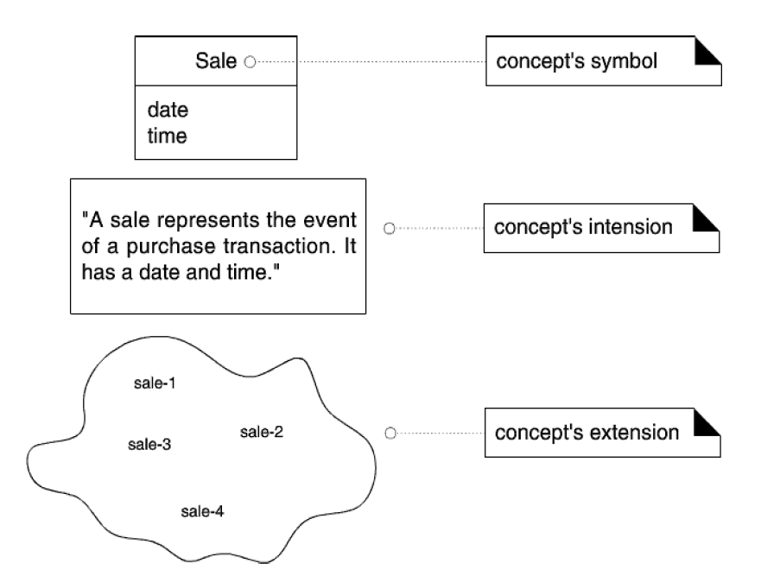
What are Concepts and Conceptual Classes?
Concept: is an idea, thing, or object. It has symbol, intension, and extensions.
Symbol --words or images representing a conceptual class
Intention --the definition of a conceptual class
Extension --the set of examples to which the conceptual class applies.

Slide 9
Why Domain Model?

Slide 10
Why do we need a domain model?
Gives a conceptual framework of the things in the problem space
Helps you think – focus on semantics
Provides a glossary of terms – noun based
Based on the defined structure, we can describe the state of the problem domain at any time.
Create a domain model to understand the key concepts and vocabulary
Lower gap between the software representation and mental model of the domain

Slide 11
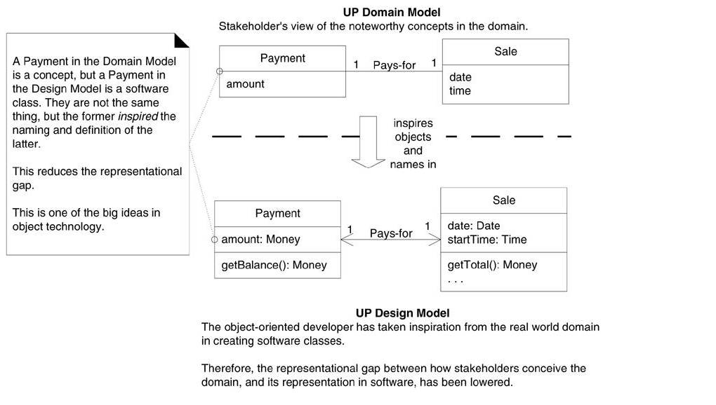
Lower representational gap with OO modeling

Slide 12
Syntax of Domain Model

Slide 13
Notation – UML Analysis Class Diagram
UML analysis class diagram is used to model a domain
Domain Class
Domain class consist of class name and attributes
Domain class does not have methods
Relation
A line with a label represents the relation between two classes
A relation has a cardinality constraint

Slide 14
Syntax of Domain Model
Class Name
Conceptual Class:
Student
age name
Association
Multiplicity/Cardinality
Registers
Registers
1
*
Attributes
Notes:
A multiplicity is a factor associated with an attribute. It specifies how many instances of attributes are created when a class is initialized. If a multiplicity is not specified, by default one is considered as a default multiplicity.

Slide 15
Relationships
There are mainly three kinds of relationships in UML:
Dependency
Generalization
Association

Slide 16
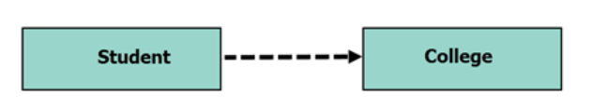
Dependency
A dependency means the relation between two or more classes in which a change in one may force changes in the other. However, it will always create a weaker relationship. Dependency indicates that one class depends on another.
In the following UML class diagram examples, Student has a dependency on College
Dependent Class

Slide 17
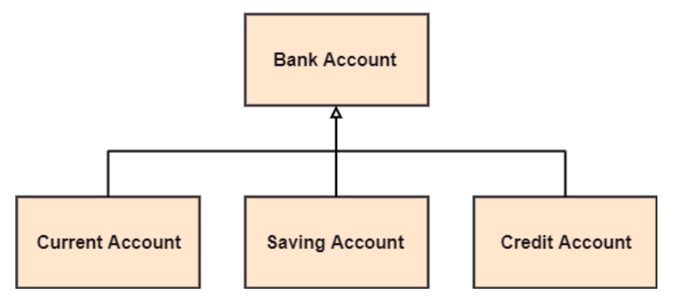
Generalization
A generalization is a relationship between a parent class (superclass) and a child class (subclass). In this, the child class is inherited from the parent class. For example, The Current Account, Saving Account, and Credit Account are the generalized form of Bank Account.

Slide 18
UML Association Notation
An association is represented as a line between classes with an association name.
Associations are inherently bidirectional.
Optional reading direction arrow is only an aid to the reader of the diagram.

Slide 19
UML Association Notation
“reading direction arrow”
It has no meaning except to indicate direction of reading the association label
Often excluded
Association name
POST
Records-current
Sale
1
1
multiplicity

Slide 20
Associations Names
Store
1
Contains
1..*
Captures
Paid-by
Post
Sale
Payment
1
1..*
1
1

Slide 21
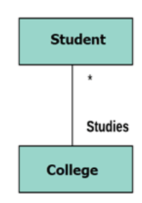
Multiplicity
A multiplicity is a factor associated with an attribute. It specifies how many instances of attributes are created when a class is initialized. If a multiplicity is not specified, by default one is considered as a default multiplicity.
Let’s say that that there are 100 students in one college. The college can have multiple students.

Slide 22
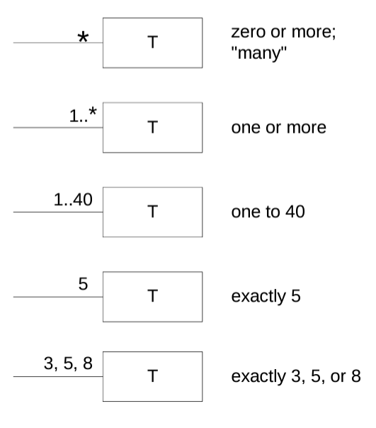
Multiplicity

Slide 23
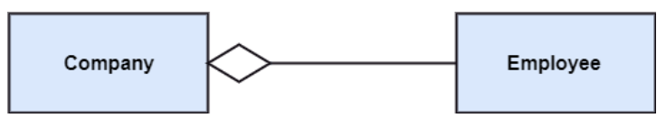
Aggregation
An aggregation is a subset of association, which represents has a relationship. It is more specific than association. It defines a part-whole or part-of relationship. In this kind of relationship, the child class can exist independently of its parent class.
Container Class
Contained Class

Slide 24
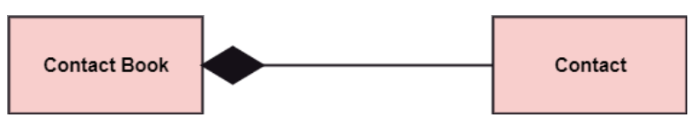
Composition
The composition is a subset of aggregation. It portrays the dependency between the parent and its child, which means if one part is deleted, then the other part also gets discarded. It represents a whole-part relationship.
A contact book consists of multiple contacts, and if you delete the contact book, all the contacts will be lost.

Slide 25
How to Create Domain Model

Slide 26
How to Create Domain Model
Find conceptual classes
Draw them as classes in a UML class diagram
Add associations and attributes

Slide 27
Finding Conceptual Classes
Three Strategies to Find Conceptual Classes
Reuse or modify the existing model if one exists
Use a Category List
Identify noun phrases in your use-cases

Slide 28
Method 1: Reuse or Modify Existing Models
There are published, well--‐crafted domain models and data models (which can be modified into domain models) for many common domains, such as inventory, finance, health, and so forth..
Reusing existing models is excellent, but out of the scope of this course

Slide 29
Method 2: Use a Category List
We can kick-start the creation of a domain model by making a list of candidate conceptual classes.
Table contains many common categories that are usually worth considering, with an emphasis on business information system needs.
The guidelines also suggest some priorities in the analysis. Examples are drawn from the
POS
Monopoly
Airline reservation domains

Slide 30
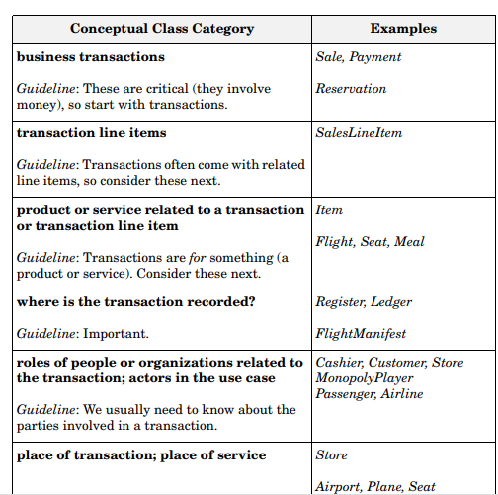
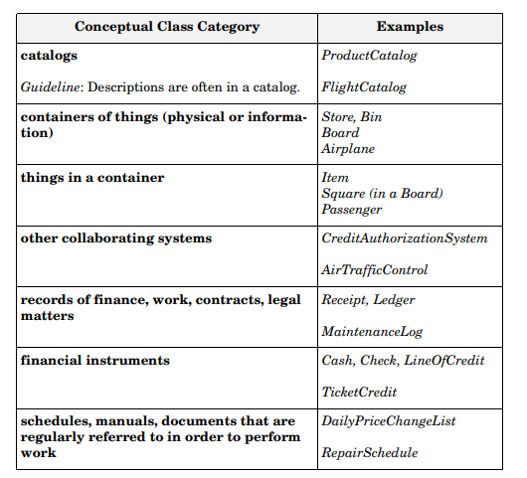
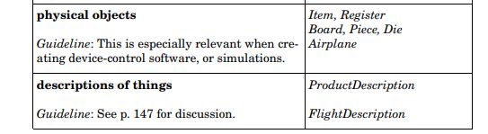

Slide 31
Method 3: Finding Conceptual Classes with Noun Phrase Identification
Another useful technique (because of its simplicity) is linguistic analysis: Identify the nouns and noun phrases in textual descriptions (use cases or other documents) of a domain and consider them as candidate conceptual classes or attributes.

Slide 32
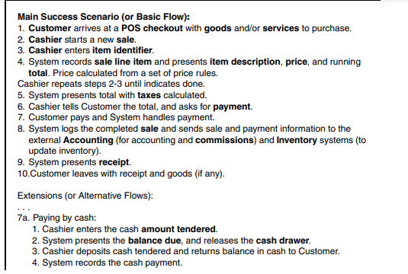
Method 3: Finding Conceptual Classes with Noun Phrase Identification
Basic Flow for a POS System

Slide 33
Example: Find and Draw Conceptual Classes
Case Study: POS Domain
From the category list and noun phrase analysis, a list is generated of candidate conceptual classes for the domain
Sale
CashPayment
SalesLineItem
Item Register
Cashier
Customer
Store
ProductDescription
ProductCatalog
.
.
.
Decide which ones are classes and which ones are attributes
Add attributes and relation to the identified domain classes

Slide 34
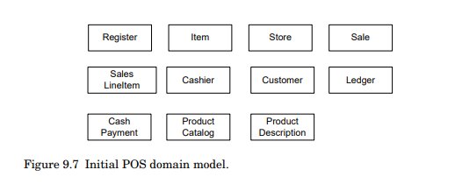
POS Domain Model

Slide 35
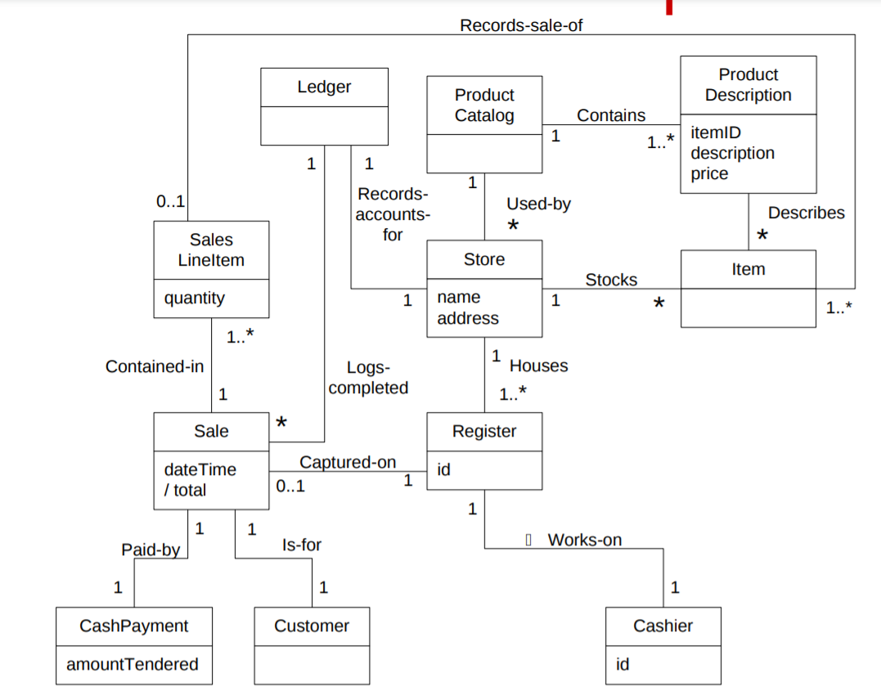

Slide 36
Domain Modeling Guidelines
On Naming and Modeling Things: The Mapmaker
Mapmakers uses the names of the territory--they do not change the names of cities on a map. For a domain model, this means to use the vocabulary of the domain when naming concepts and attributes. For example, if developing a model for a library, name the customer a “Borrower” --the term used by the library staff.
A mapmaker deletes things from a map if they are not considered relevant to the purpose of the map; a domain model may exclude concepts in the problems domain not pertinent to the requirements.
A mapmaker does not show things that are not there, such as a mountain that does not exist. Similarly, the domain model should exclude things not in the problem domain under consideration.

Slide 37
Domain Modeling Guidelines
On Naming and Modeling Things: The Mapmaker
Make a domain model in the spirit of how a mapmaker works:
Use the existing names in the territory.
Exclude irrelevant features.
Do not add things that are not there.

Slide 38
Resolving Similar Concepts - POST versus Register
Rule of thumb, a domain model is not absolutely correct or wrong, but useful tool of communication.
Both POST and Register are equally useful terms but POST will give a better implementation view.
Notes:
the POST request method requests that a web server accept the data enclosed in the body of the request message, most likely for storing it

Slide 39

Concept vs. Attribute
A Common Mistake in Identifying Concepts:
Attribute OR Concept?
If we do not think of some concept X as a number or text in the real world,
X is probably a concept, not an attribute.
If in doubt, make it a separate concept.

Slide 40
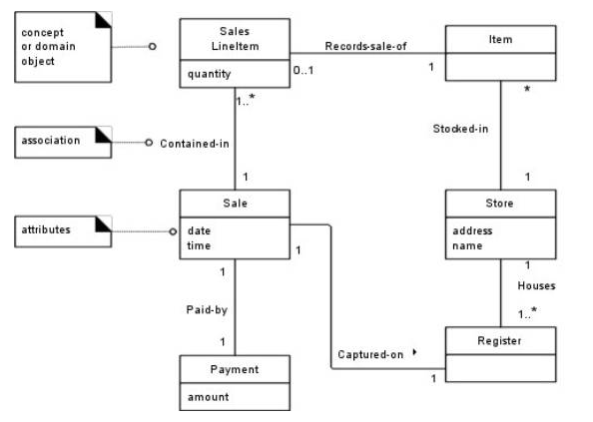
UML Attribute Notation

Slide 41
Conclusion
When in doubt if the concept is required, keep the concept.
When in doubt if the association is required, drop it.

Slide 42
Monopoly Game domain model (first identify concepts as classes)
Monopoly Game
Dice
Board
Player
Piece
Square

Slide 43
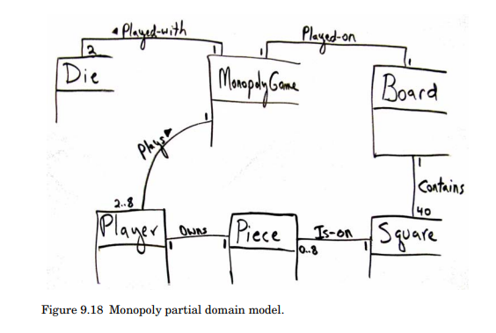

Slide 44
Visualizing Domain Models

Slide 45
Archaeologist Management System
You have been asked to build a management system for a group of archeologists. The group is comprised of multiple teams of researchers. Each team has a letter ID (e.g., team A, team B). Each researcher belongs to one of the teams, and has an ID number, a first name, and a last name. There are two types of researchers: field staff and lab staff. Each field staff member has a favorite region (string). Each lab researcher supports up to 2 field researchers. Some researchers may not be supported by a lab researcher. The archaeologist group also manages an inventory of equipment. Researchers of any type may check out up to 3 pieces of equipment. Each piece of equipment has a serial number and replacement cost.

Slide 46
Archaeologist Management System Identify Nouns
You have been asked to build a management system for a group of archeologists. The group is comprised of multiple teams of researchers. Each team has a letter ID (e.g., team A, team B). Each researcher belongs to one of the teams, and has an ID number, a first name, and a last name. There are two types of researchers: field staff and lab staff. Each field staff member has a favorite region (string). Each lab researcher supports up to 2 field researchers. Some researchers may not be supported by a lab researcher. The archaeologist group also manages an inventory of equipment. Researchers of any type may check out up to 3 pieces of equipment. Each piece of equipment has a serial number and replacement cost.

Slide 47
Archaeologist Management System Identify Associations and Multiplicity
You have been asked to build a management system for a group of archeologists. The group is comprised of multiple teams of researchers. Each team has a letter ID (e.g., team A, team B). Each researcher belongs to one of the teams, and has an ID number, a first name, and a last name. There are two types of researchers: field staff and lab staff. Each field staff member has a favorite region (string). Each lab researcher supports up to 2 field researchers. Some researchers may not be supported by a lab researcher. The archaeologist group also manages an inventory of equipment. Researchers of any type may check out up to 3 pieces of equipment. Each piece of equipment has a serial number and replacement cost.

Slide 48
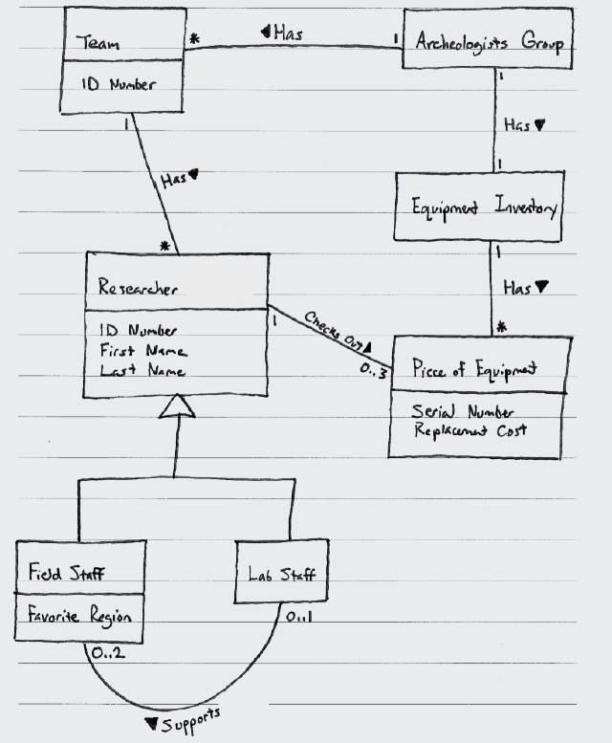

Slide 49
Statements about a Course Management System
During a semester, a lecturer reads one or more lectures
Sometimes the lecturer is on leave to focus on doing research, in this case (s)he does not give a lecture
A student usually attends one or more lectures, unless (s)he has something better to do
During the semester there will be several exercises which are meant to be solved by small study groups
Each student is assigned to one particular study group for the whole semester
A study group consists of two to three students
After submission of a solution by a study group it is graded by a tutor
...

Slide 50







A class describes a set of objects with the same semantics, properties and behavior.
During a semester a lecturer reads one or more lectures
A student usually attends one or more lectures, ...
During the semester there will be several exercises...
Each student is assigned to one particular study group for the whole Semester
... it is graded by a tutor
Tutor
Exercise
Semester
Student
Lecture
Lecturer
Grade
Study Group

Slide 51






Attributes are logical data values of an object.
... after submitting a solution, it is graded by a tutor
The bonus is a relative bonus that reﬂects the relative number of exercise points gained during the semester
....
Student
name
/bonus : Percentage
attributes
derived attribute ("/")
The bonus is derived

Slide 52
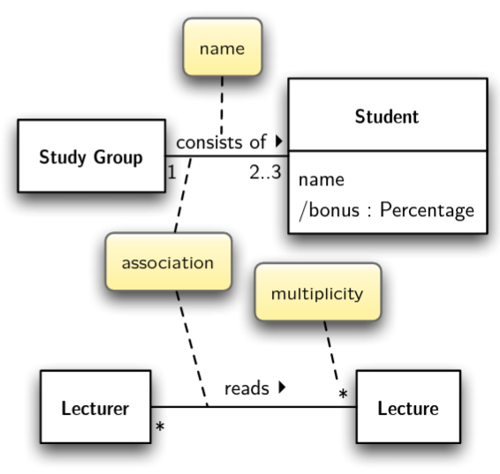
The ends of an association are called roles. Roles optionally have a multiplicity, name and navigability.
A lecturer reads one or more lectures...
A student usually attends one or more lectures...
A study group consists of two to three students...
During the semester there will be several exercises
1..

Slide 53
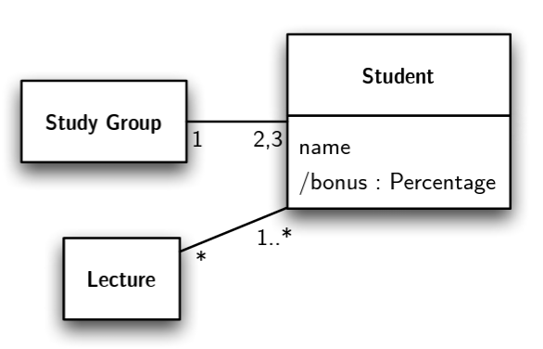
The multiplicity defines how many instances of a class A can be associated with one instance of a class B at any particular moment.
(e.g., * ≙ zero or more; 1..10 between 1 and 10; 1,2 one or two)
A student usually attends one or more lectures, unless (s)he has something better to do
A study group consists of two to three students...
...

Slide 54
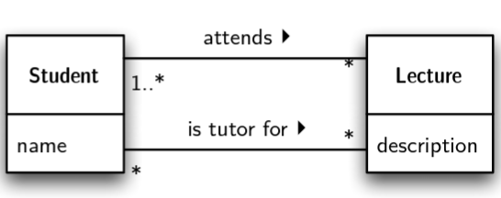
Two Classes can have multiple associations
A student usually attends one or more lectures, unless the student has something better to do
A study group consists of two to three students; after submitting a solution it is graded by a tutor who is also a student

Slide 55










A preliminary domain model for a course management system.
Student
Lecture
Lecturer
attends ‣
◀ reads
1..*
name
/bonus : Percentage
1..*
1..*
description
*
name
2..3
1
consists of ‣
owns ‣
12..14
Exercise
1
StudyGroup
solves ‣
task
submission date exercise points
*
*
Solution
The Domain Model is sometimes also called a Visual Dictionary.
achieved exercise points

Slide 56
Hospital Management System
Ward is a division of a hospital or a suite of rooms shared by patients who need a similar kind of care. In a hospital, there are a number of wards, each of which may be empty or have on it one or more patients. Each ward has a unique name. Wards are differentiated by gender of its patients, i.e. male wards and female wards. A ward can only have patients of the gender admitted to it. Every ward has a fixed capacity, which is the maximum number of patients that can be on it at one time (i.e. the capacity is the number of beds in the ward).
Different wards may have different capacities. The doctors in the hospital are organized into teams (also called firms). Each team has a unique name or code (e.g. Orthopedics or Pediatrics) and is headed by a consultant doctor (in the UK, Republic of Ireland, and parts of the Commonwealth) or attending physician (also known as staff physician) (in the United States).
Consultant doctor or attending physician is the senior doctor who has completed all of his or her specialist training, residency and practices medicine in a clinic or hospital, in the specialty learned during residency. She or he can supervise fellows, residents, and medical students.
The rest of the team are all junior doctors. Each doctor could be a member of no more than one team. Each patient is on a single ward and is under the care of a single team of doctors. A patient may be treated by any number of doctors but they must all be in the team that cares for the patient.
A doctor can treat any number of patients. The team leader accepts ultimate responsibility, legally and otherwise, for the care of all the patients referred to him/her, even with many of the minute-to-minute decisions being made by subordinates.

Slide 57
Hospital Management System
Ward is a division of a hospital or a suite of rooms shared by patients who need a similar kind of care. In a hospital, there are a number of wards, each of which may be empty or have on it one or more patients. Each ward has a unique name. Wards are differentiated by gender of its patients, i.e. male wards and female wards. A ward can only have patients of the gender admitted to it. Every ward has a fixed capacity, which is the maximum number of patients that can be on it at one time (i.e. the capacity is the number of beds in the ward).
Different wards may have different capacities. The doctors in the hospital are organized into teams (also called firms). Each team has a unique name or code (e.g. Orthopedics or Pediatrics) and is headed by a consultant doctor (in the UK, Republic of Ireland, and parts of the Commonwealth) or attending physician (also known as staff physician) (in the United States).
Consultant doctor or attending physician is the senior doctor who has completed all of his or her specialist training, residency and practices medicine in a clinic or hospital, in the specialty learned during residency. She or he can supervise fellows, residents, and medical students.
The rest of the team are all junior doctors. Each doctor could be a member of no more than one team. Each patient is on a single ward and is under the care of a single team of doctors. A patient may be treated by any number of doctors but they must all be in the team that cares for the patient.
A doctor can treat any number of patients. The team leader accepts ultimate responsibility, legally and otherwise, for the care of all the patients referred to him/her, even with many of the minute-to-minute decisions being made by subordinates.

Slide 58
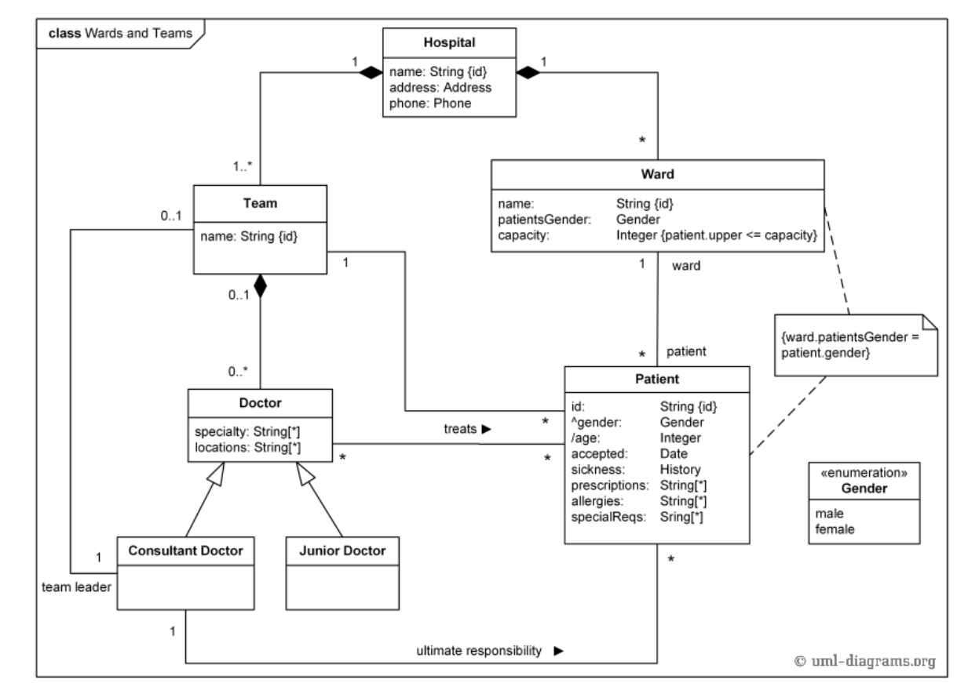

Slide 59
Hotel Management System
Identify Use Cases
Identify Conceptual Classes
Hotels are the place where you stay, eat meals and utilize their other services. As computer has merged with man as single entity so a computerized application can be developed that can handle Hotel Management System (HMS). Various activities take place in hotel like Hotel needs to maintain the record of guests and reserve rooms beforehand. Customers should be able to know the availability of the rooms on a particular date. They should be able to reserve the available rooms according to their need in advance. To make their stay comfortable, they are provided with food and other services. The record of the food taken by each customer and the services availed by the customer should be kept. These records help in generating bill. All the above activity takes place manually, manually carrying out this activity in very tedious time consuming. As we have tried to develop computerized application so as to handle all the activity that takes place in Hotel. As all the activities that happen in the Hotel such as enquiry, check status booking, food order etc. can be handled on this system simultaneously.

Slide 60
Use Cases
Cancel Room Booking
Check-in
Check-out
Manage Rooms
Manage Services
Search Customer
Registration
Check Room Availability
Manage Orders
Manage Employees
Book Room/ Reserve Room
Place Order
Make Payment
Update Inventory
Generate Bills
Order Food
Generate Report
Manage Guest
Book Table

Slide 61
Identification of Conceptual Classes
Hotel needs to maintain the record of guests and reserve rooms beforehand.
Customers should be able to know the availability of the rooms on a particular date.
Customers should be able to reserve the available rooms according to their need in advance.
To make their stay comfortable, they are provided with food and other services.
The record of the food taken by each customer and the services availed by the customer should be kept.
These records help in generating bill.
As all the activities that happen in the Hotel such as enquiry, check status booking, food order etc. can be handled on this system simultaneously.

Slide 62
Domain Model Conceptual Classes
Customer
Food
Manager
Report
Room
Customer
Inventory
Reservation
Table
Hotel
Receptionist
Guest
Bill
Order
Services
Inventory Manager
Payment

